Slide 1


Practicum Presentation:2nd Defense Topic: Credit Card Fraud Detection
MANIK DIWAN (01917711621) AI&ML
KRISHNA GOEL (02717711621) AI&ML
Supervisor: Dr.Gopal

Slide 2
Index of Contents
Introduction & Motivation
Problem Statement
Background Study
Project Progress/Implementation(screenshots/video etc.)
Results
Conclusion

Slide 3
1. Introduction & Motivation
Credit card fraud detection is a critical aspect of the financial industry. The rise in online transactions has made it easier for fraudsters to exploit vulnerabilities in payment systems and steal credit card information. To prevent such fraudulent activities, various fraud detection techniques are employed by financial institutions and merchants.
The primary objective of credit card fraud detection is to identify fraudulent transactions accurately while minimizing false positives. Fraud detection systems use machine learning algorithms and statistical analysis to identify suspicious patterns and behaviors that indicate fraudulent activity.

Slide 4
1. Introduction & Motivation
Unsupervised learning techniques like clustering and anomaly detection are also used to identify unusual patterns that may indicate fraudulent activity.
Fraud detection systems are continuously updated to keep pace with the changing nature of fraud. The effectiveness of these systems is critical to maintain consumer trust in the financial system and prevent significant financial losses to both consumers and financial institutions. Overall, credit card fraud detection is an essential area of research that combines advanced data analysis techniques and machine learning algorithms to detect and prevent fraudulent activity.

Slide 5
2. Problem Statement
The problem of credit card fraud is a significant challenge for financial institutions and merchants worldwide. Fraudulent activities not only result in significant financial losses but also erode consumer trust in the financial system. Fraudsters use sophisticated techniques to exploit vulnerabilities in payment systems and steal credit card information, leading to unauthorized transactions and chargebacks. The challenge for financial institutions and merchants is to detect fraudulent transactions accurately while minimizing false positives.

Slide 6
3. Background Study
Outliers:- Outlier is an extremely high or extremely low data point relative to the nearest data point and the rest of the neighboring co-existing values in a data graph or dataset you're working with
Correlation:- Correlation quantifies the strength of the linear relationship between a pair of variables, whereas regression expresses the relationship in the form of an equation. Correlation() method in Python is used to return Pearson's correlation coefficient between two inputs. The Pearson's correlation formula is: Where: r = The correlation coefficient. It is usually between -1 (negative correlation) and +1 (positive correlation).

Slide 7
3. Background Study
Isolation Forest:- A low linear time complexity and a small memory requirement. It builds a good performing model with a small number of trees using small sub-samples of fixed size, regardless of the size of a data set. The Isolation Forest algorithm isolates observations by randomly selecting a feature and then randomly selecting a split value between the maximum and minimum values of the selected feature
Local outlier factor(LOF):- It computes the local density deviation of a given data point with respect to its neighbors.

Slide 8
4. Project Progress
As a team, we have made significant strides in its development, and I have attached pictures to showcase the various stages of our progress. Specifically, we have accomplished the following milestones:
Transaction class distribution graph
Histograms of transaction amounts for fraud and normal transactions separately
Scatter plots of transaction amounts against the time of transactions for fraud and normal transactions separately

Slide 9
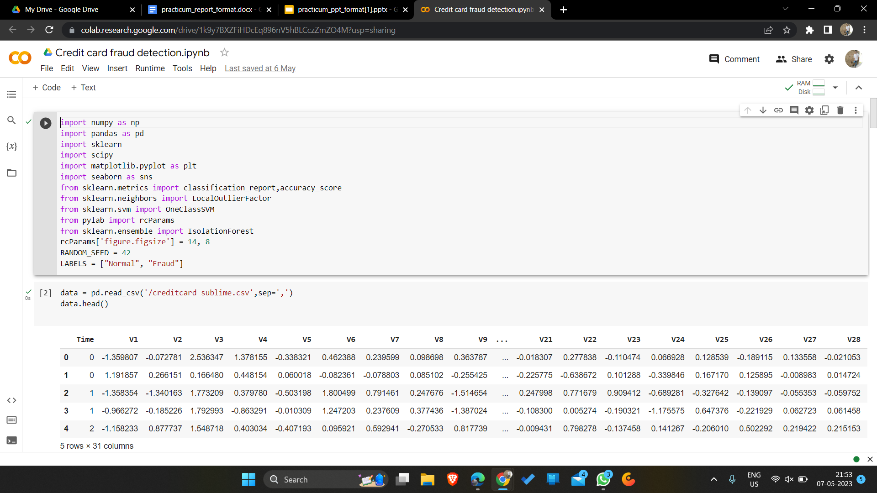
4. Project Progress

Slide 10
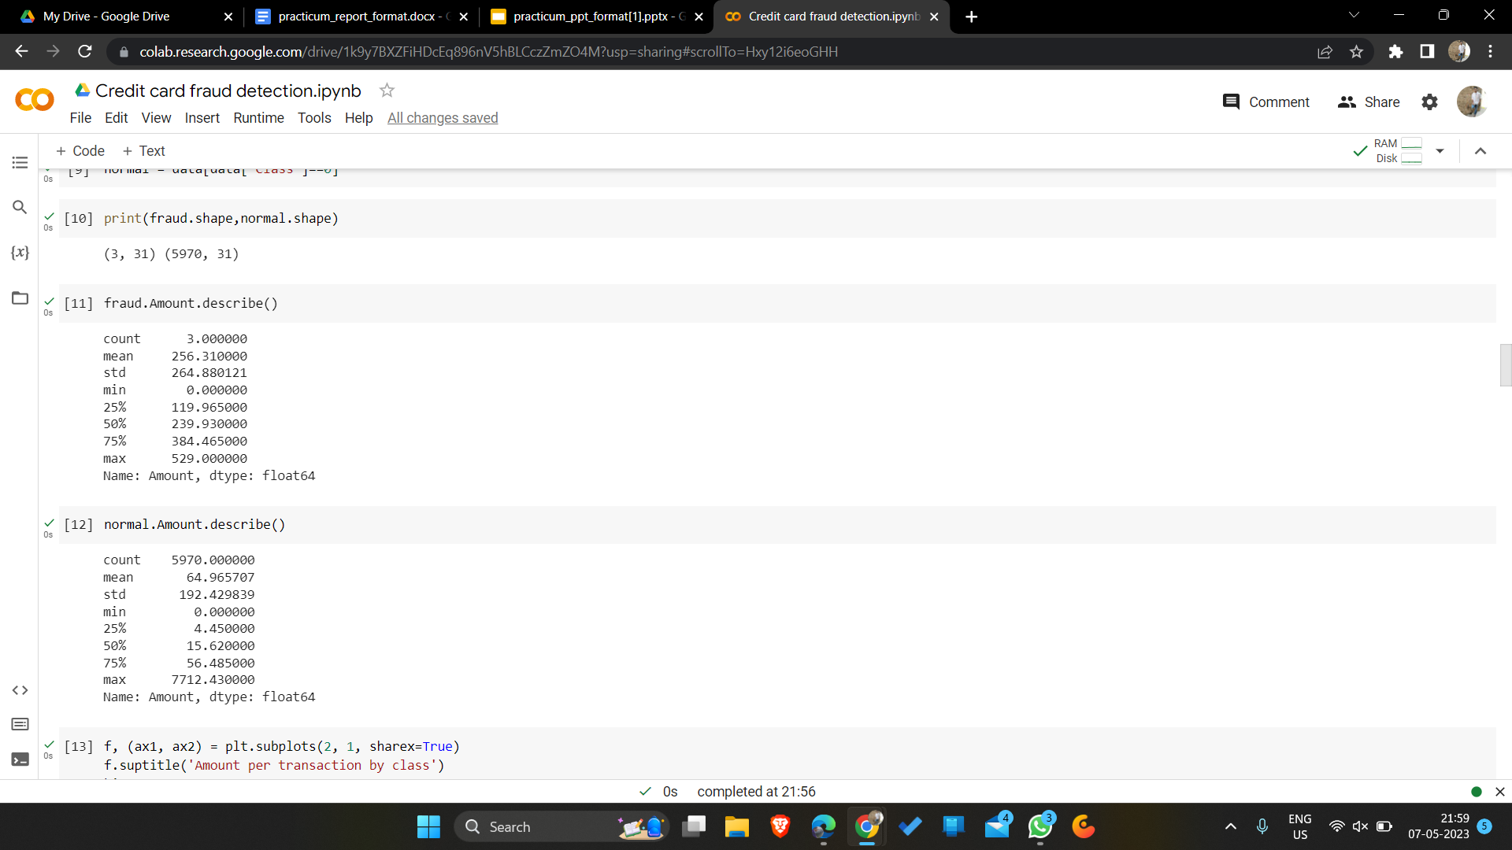
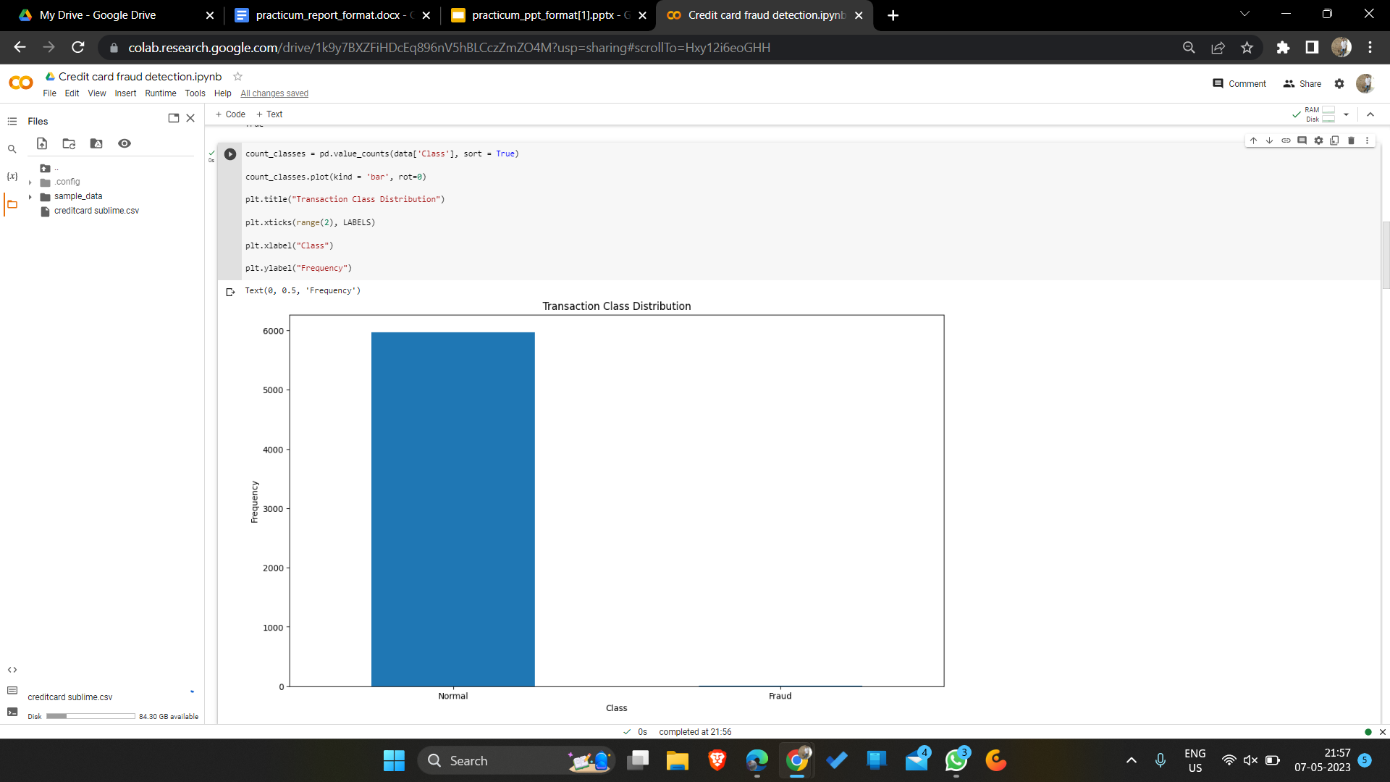
4. Project Progress

Slide 11
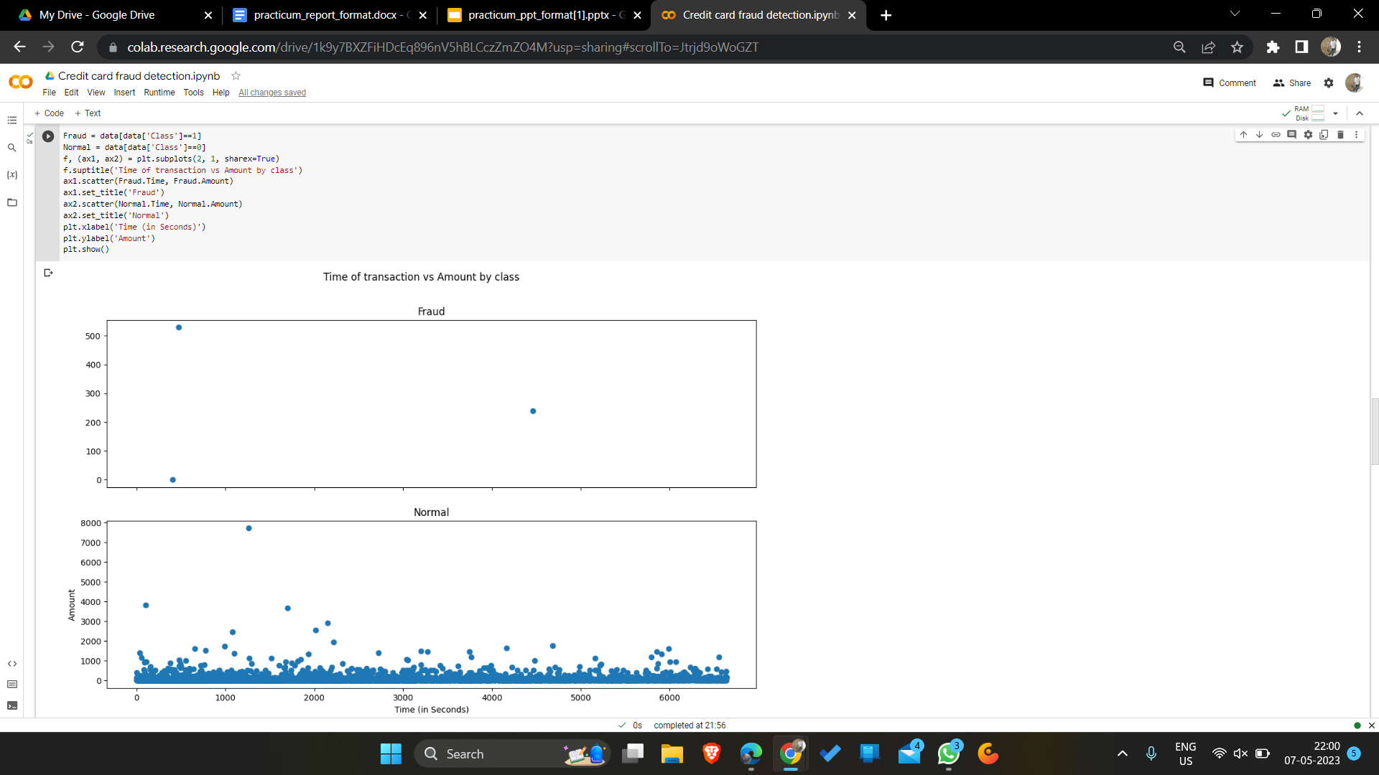
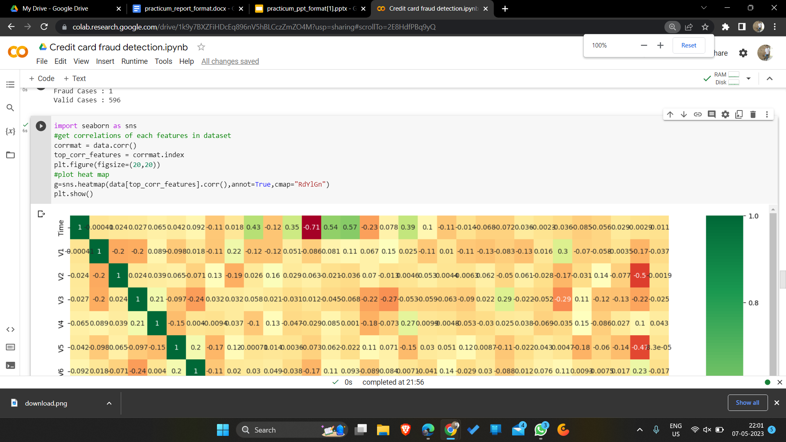
4. Project Progress

Slide 12
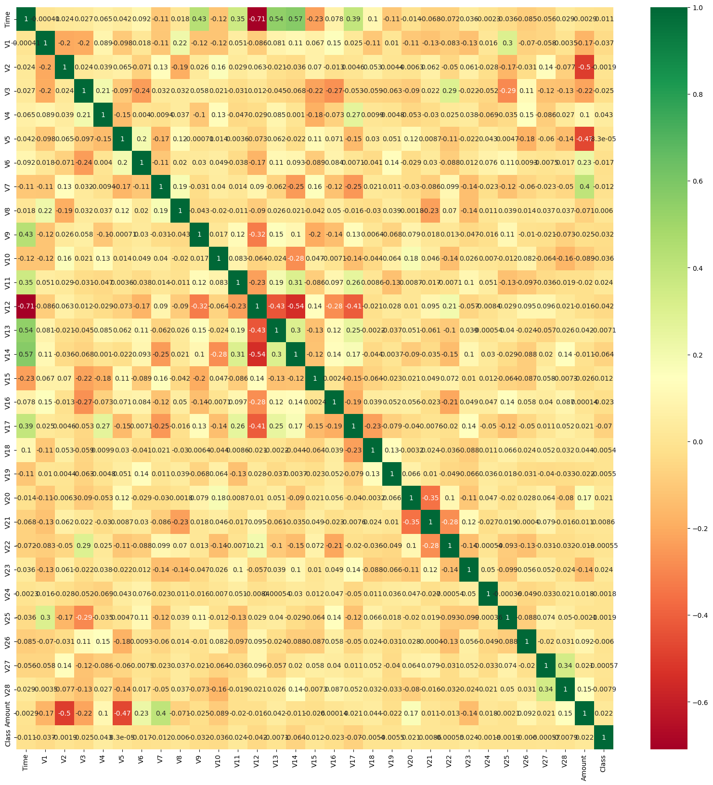
4. Project Progress

Slide 13
Pictorial Representation of Results achieved by various machine learning algorithms-

Slide 14
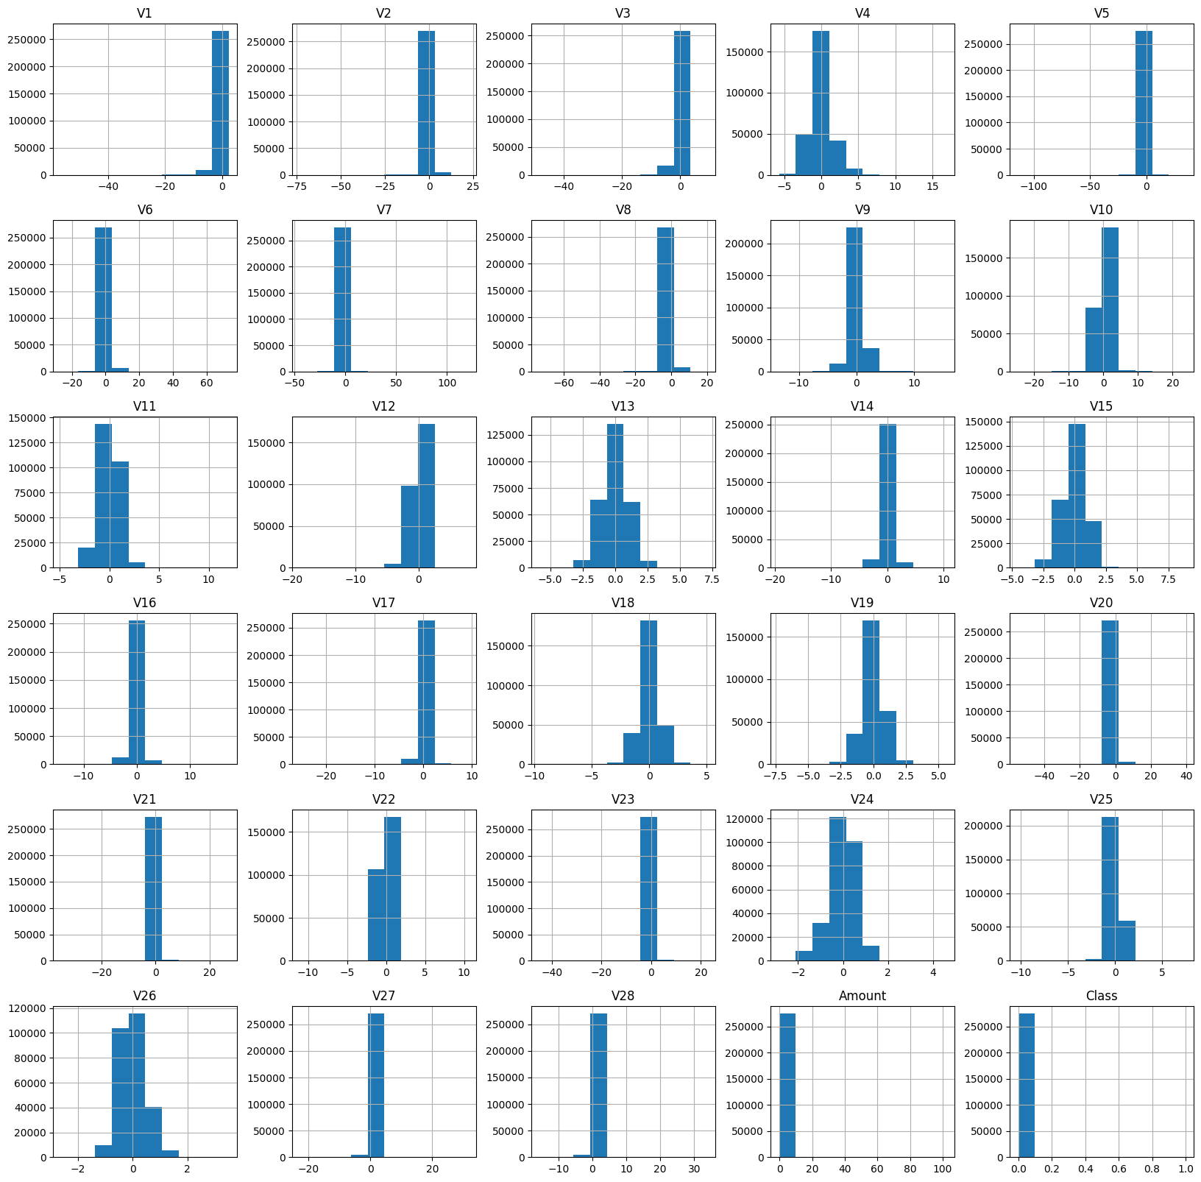
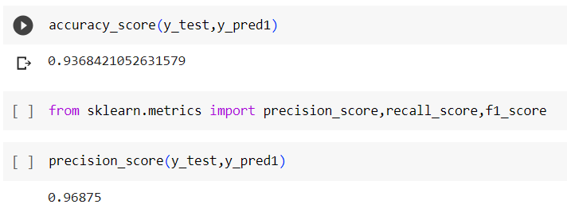
Histograph of Logistic Regression

Slide 15
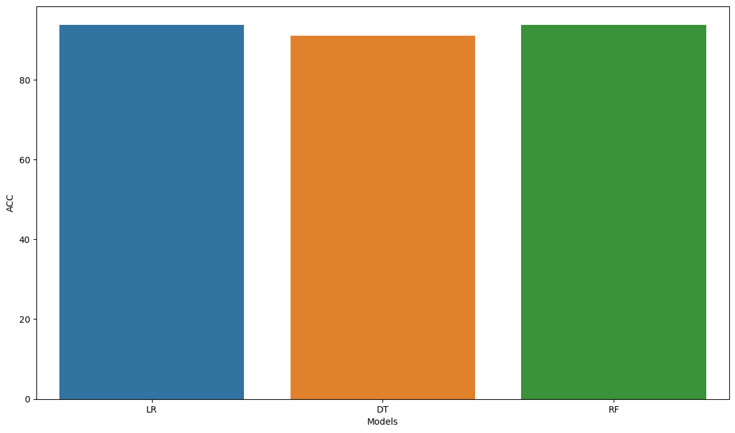
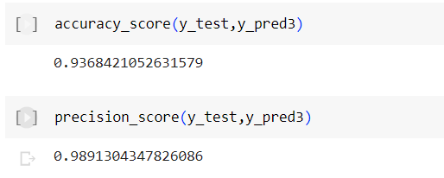
Bargraph of Random Forest

Slide 16
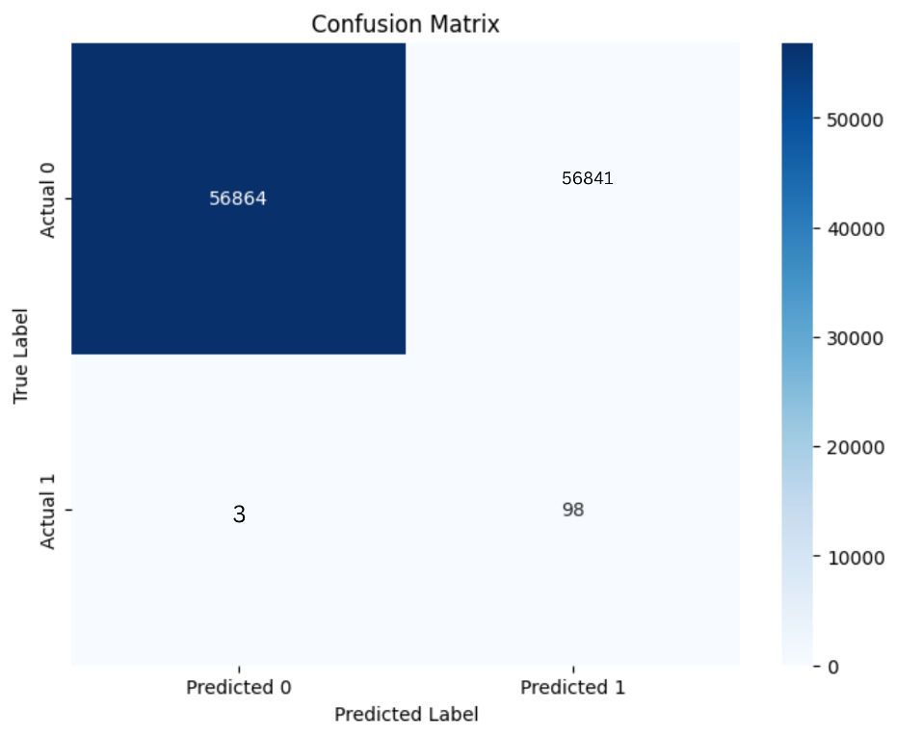
Confusion matrix of random

Slide 17
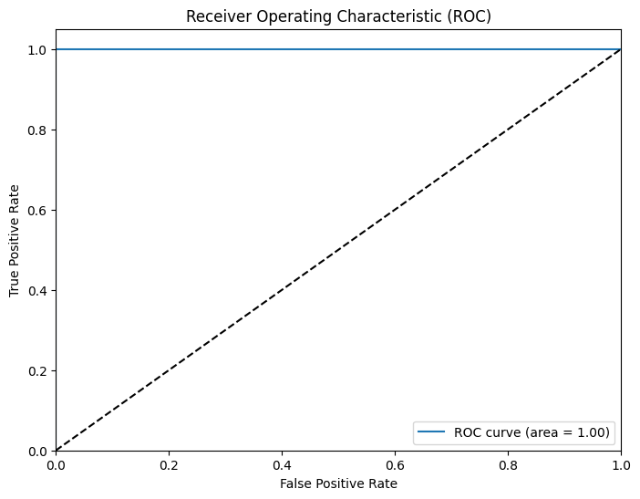
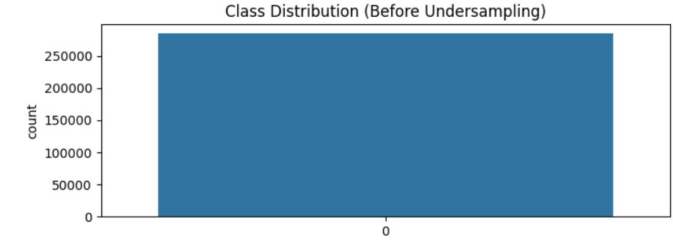
Class Distribution before undersampling
True positive vs False positive

Slide 18
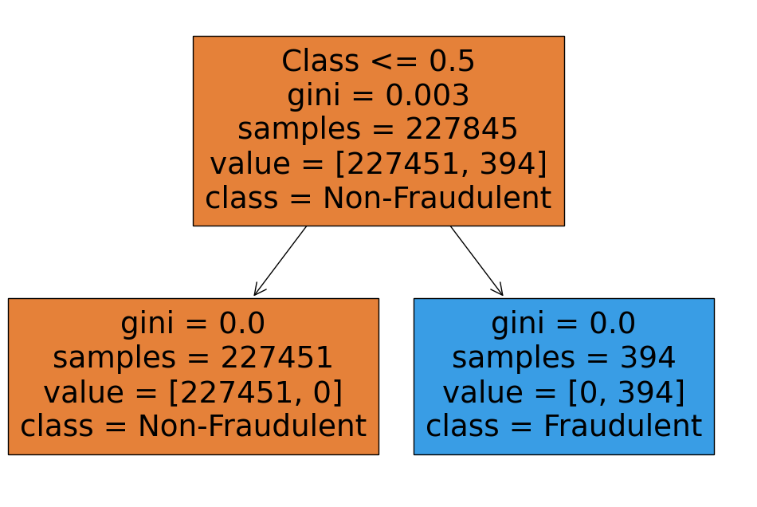
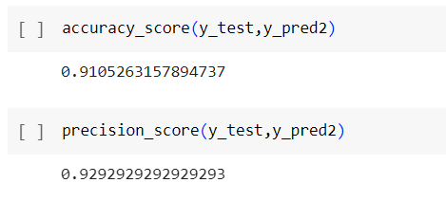
Graph for Decision Tree

Slide 19
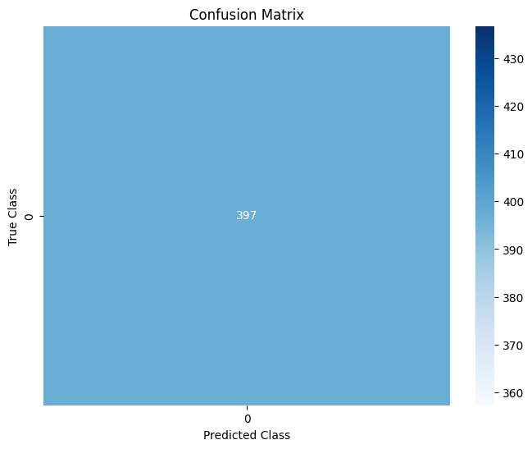
Confusion matrix of neural network
Confusion matrix of SVM

Slide 20
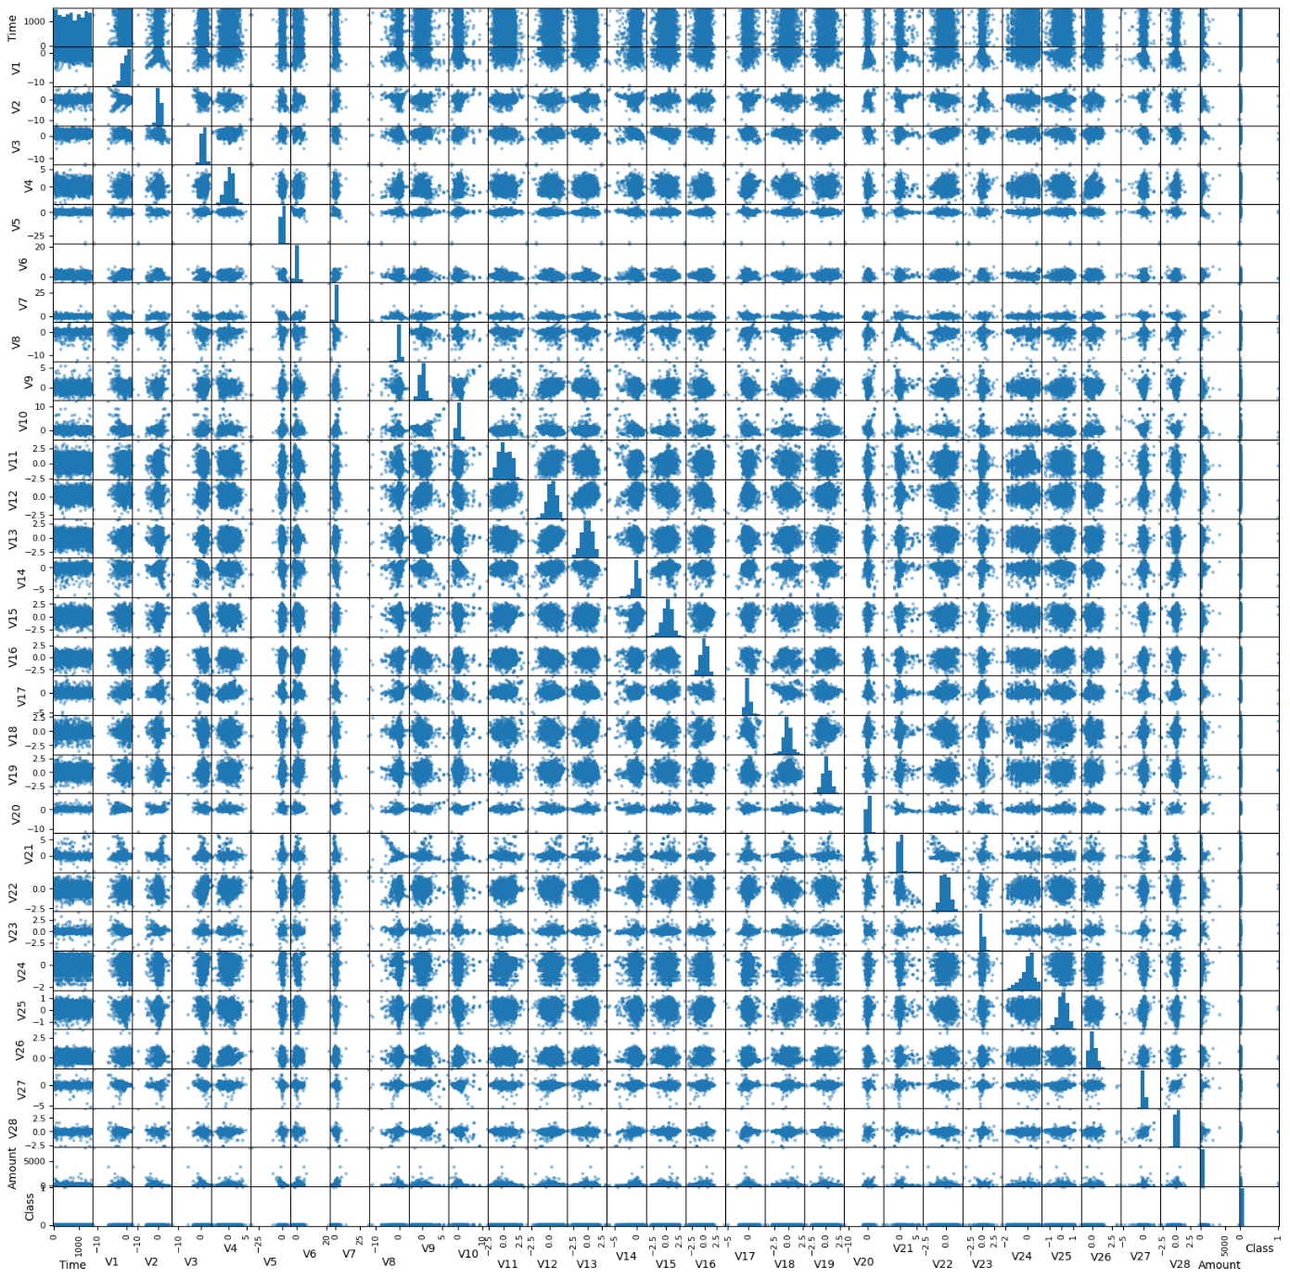
Scatter matrix

Slide 21
Machine Learning Techniques used
Neural Network- This algorithm is used by various researchers for detecting the CCF. Researchers (Murli, et al 2015) said the credit frauds are increasing because of the increasing interest in online shopping. They implemented a mechanism based on neural network to detect this kind of fraud. Researchers also used this algorithm for the detection of increasing CCF activities.
Decision Tree- We used the decision tree for the detection of credit card frauds. Researchers said, increasing use of internet and online business is also increasing so it is necessary to have a mechanism to deal with this problem. Researchers also used this algorithm for CCF detection. CCF affects both i.e. merchants and the individual clients. This makes it an interesting topic in the machine learning (Gaikwad et al., 2014).

Slide 22
Random Forest-We used this algorithm for detecting the increasing CCFs in online and offline payments. Criminal’s theft the credit information by using different techniques such as phishing or Trojan (Donepudi, 2014).
SVM- We proposed a new approach to detect the CCF. This approach is based on SVM and detects the fraud on the basis of the customer’s behavior. Researchers (Movva et al., 2012) also used a support vector based approach to save the bank from different kind of frauds on the basis of customers’ behavior.
Logistic Regression- We used this algorithm to detect the increasing frauds related to the credit. Researchers said this is an important and rising issue in the financial sector. Researchers (Movva et al., 2012) compared performance of different ML algorithms for CCF detection. This algorithm is considered better than the other algorithms on the basis of results.

Slide 23
Conclusion
In today's digital age, credit card fraud has become a prevalent concern, threatening the security of financial transactions and the trust between consumers and financial institutions. Credit card fraud detection projects play a vital role in mitigating these risks and safeguarding the interests of both cardholders and financial institutions. The future of credit card fraud detection lies in the integration of advanced technologies and innovative approaches. Machine learning and artificial intelligence algorithms have demonstrated great potential in detecting fraudulent activities by learning patterns from large datasets.
Deep learning techniques, such as convolutional neural networks (CNNs) and recurrent neural networks (RNNs), offer exciting possibilities for credit card fraud detection. Real-time monitoring enhances fraud detection accuracy and minimizes the impact of fraudulent transactions, reducing financial losses for both cardholders and financial institutions. Behavior-based analysis is gaining traction as an effective approach to fraud detection. Analyzing user behavior provides a personalized and dynamic approach to fraud detection, enabling early detection and mitigation of fraudulent activities. By incorporating biometric authentication into the fraud detection process, the risk of fraudulent transactions can be significantly reduced. Collaboration and data sharing among financial institutions and credit card companies present a significant opportunity to improve fraud detection capabilities. By sharing anonymized data and leveraging data fusion techniques, a comprehensive view of fraudulent activities can be obtained. This collaborative effort enables the identification of fraud patterns that span multiple accounts or institutions, empowering proactive measures to prevent fraud on a larger scale.

Slide 24
In conclusion, credit card fraud detection projects have a bright future ahead, driven by the continuous advancement of technology and the adoption of innovative approaches. By integrating machine learning, deep learning, real-time monitoring, behavior-based analysis, biometric authentication, collaborative efforts, advanced data analytics, explainable AI, and stringent data privacy measures, credit card fraud detection systems can become more accurate, efficient, and resilient. These advancements will contribute to a safer and more secure environment for credit card transactions, instilling confidence in consumers and financial institutions alike.

Slide 25
THANK YOU!

